Slide 1
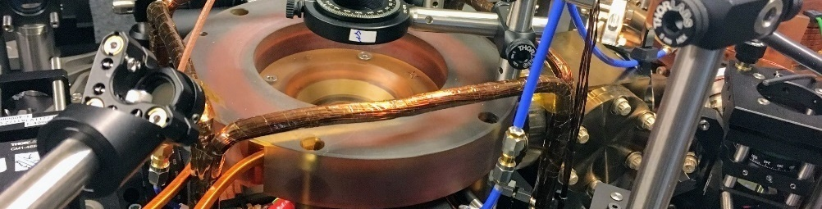
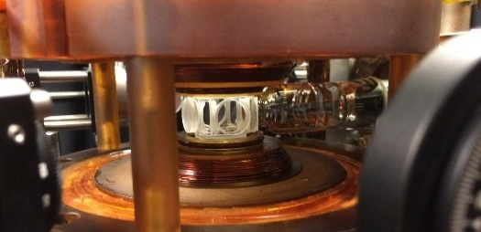
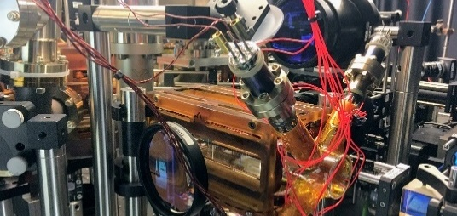
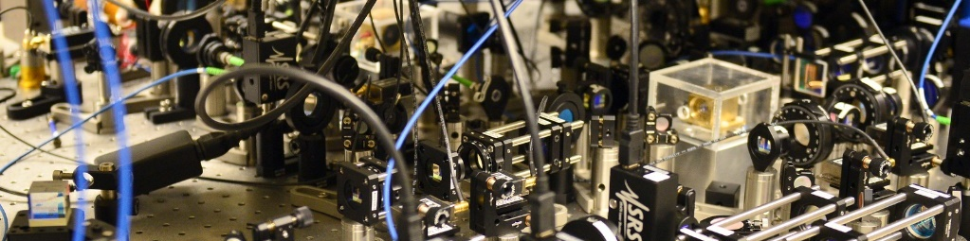








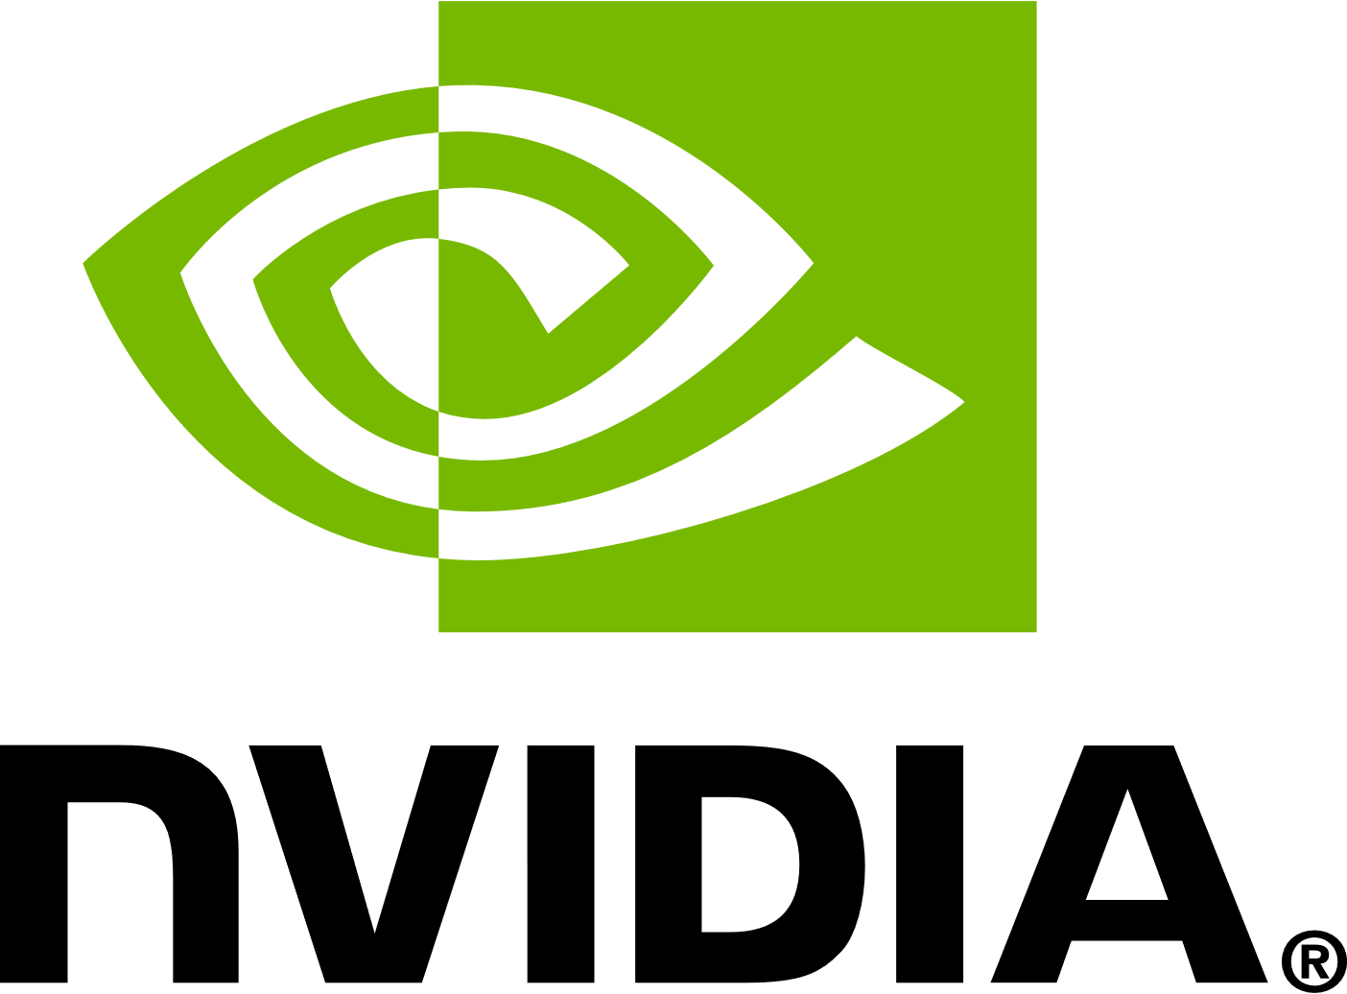
Deep-Neural-Network-based atomic absorption image denoising
Gal Ness, Sagi group
Physics Department, Technion IIT
absDL

Slide 2
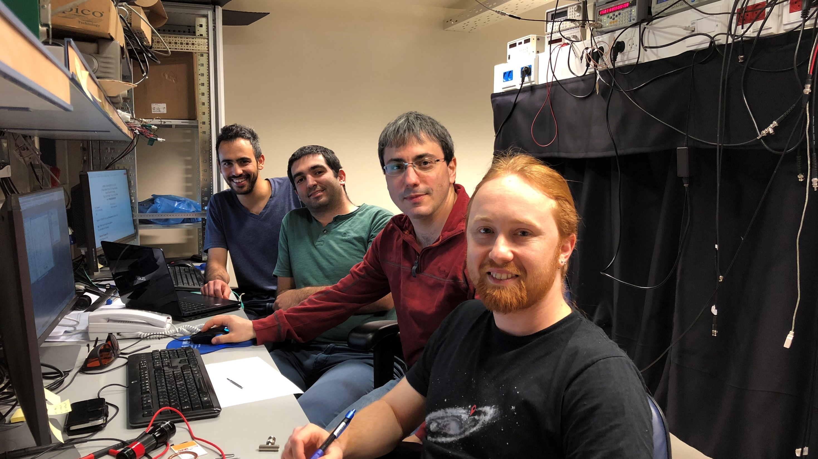
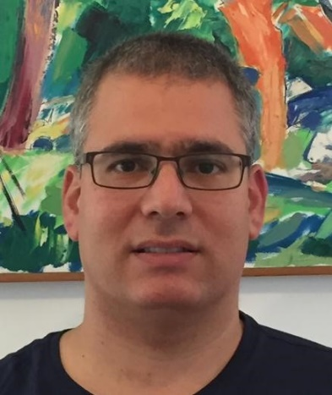
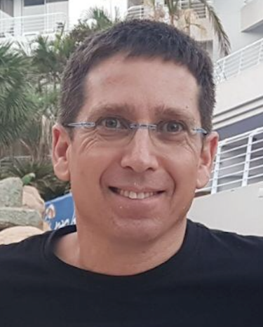
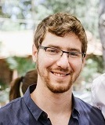
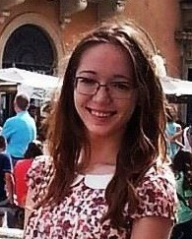
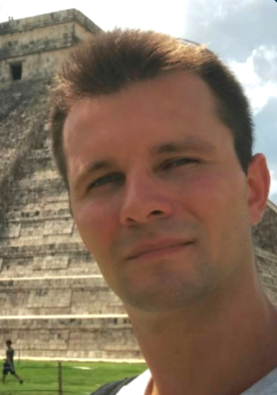
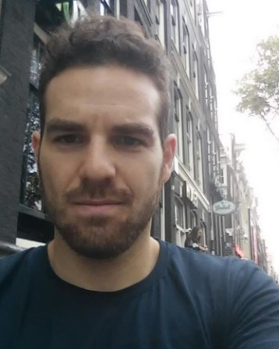
Dr. Amit Stern
Dr. Jonathan Nemirosky
Yanay
Florsheim
Prof. Yoav Sagi
Oded
Zilberman
Anastasiya
Vainbaum
Kostya Shkedrov
Meny
Menashes
Yigal Ilin

Slide 3
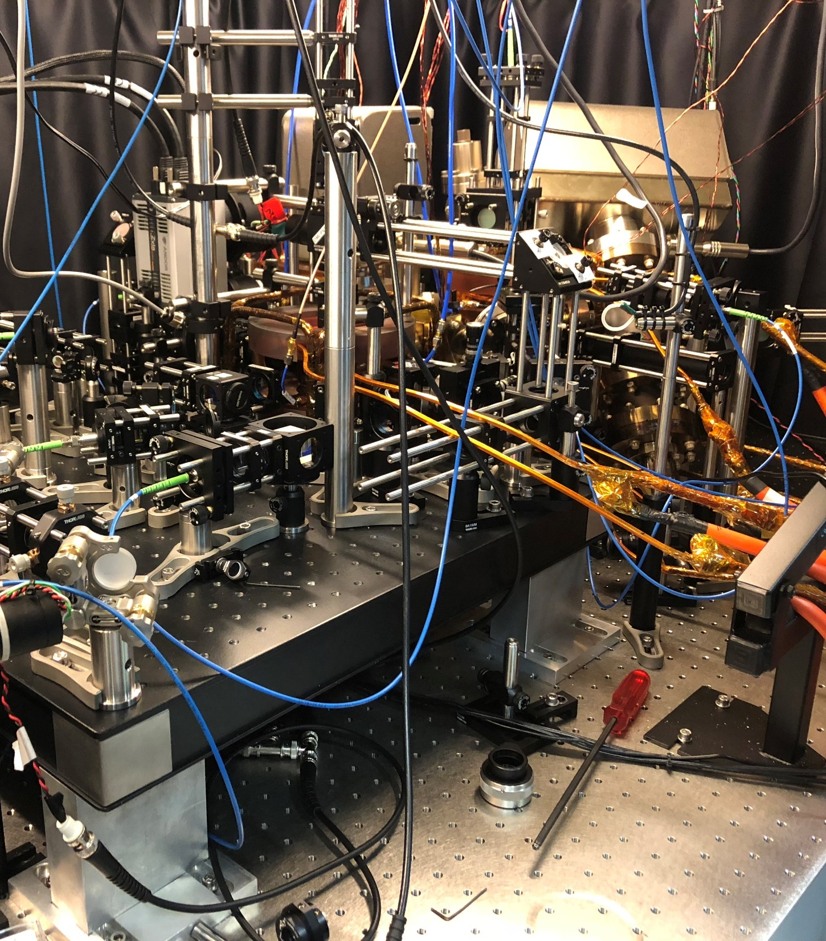
Experiments with ultracold quantum degenerate Fermi gas

Slide 4
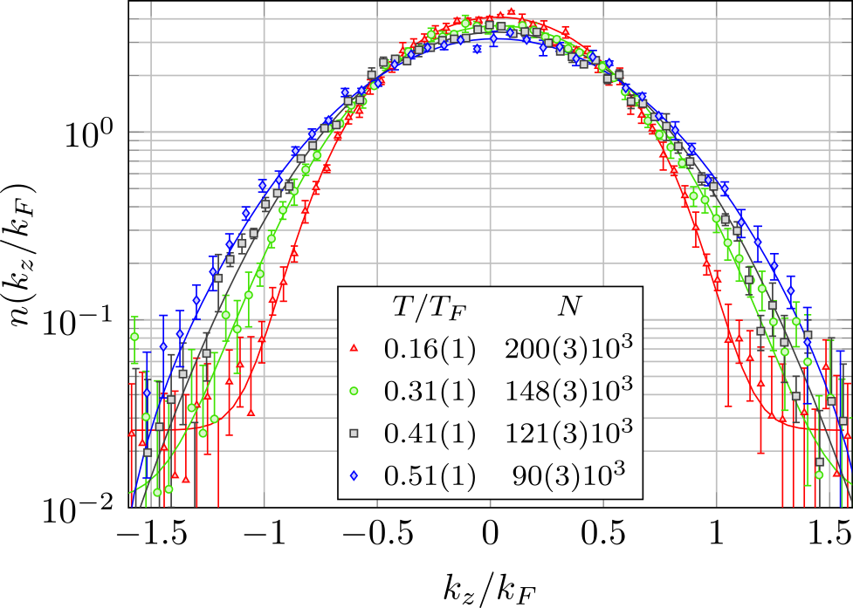
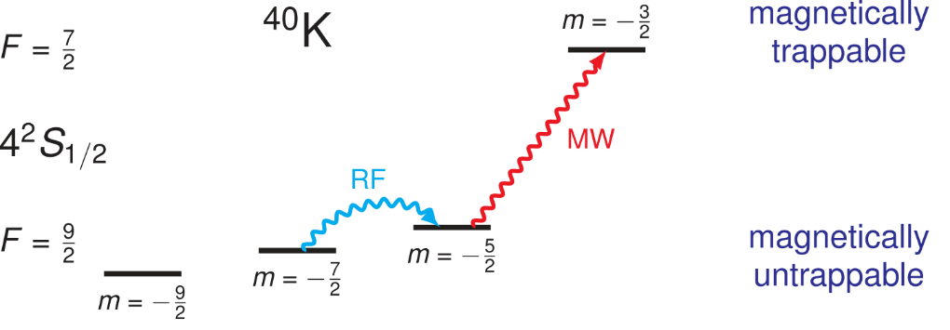
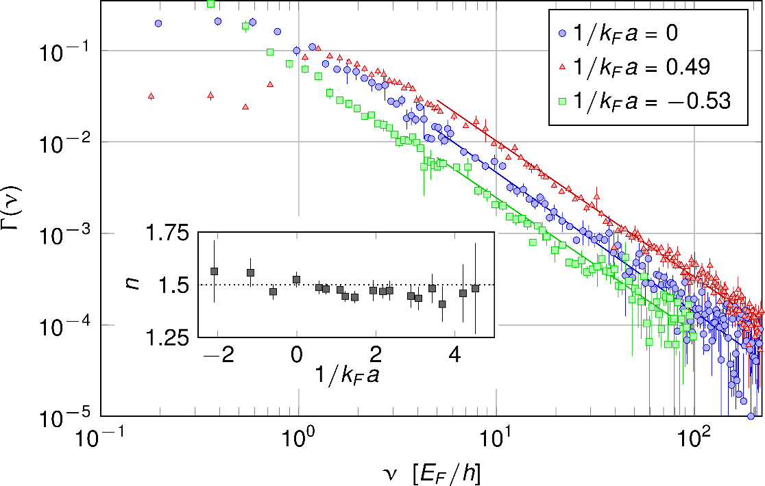
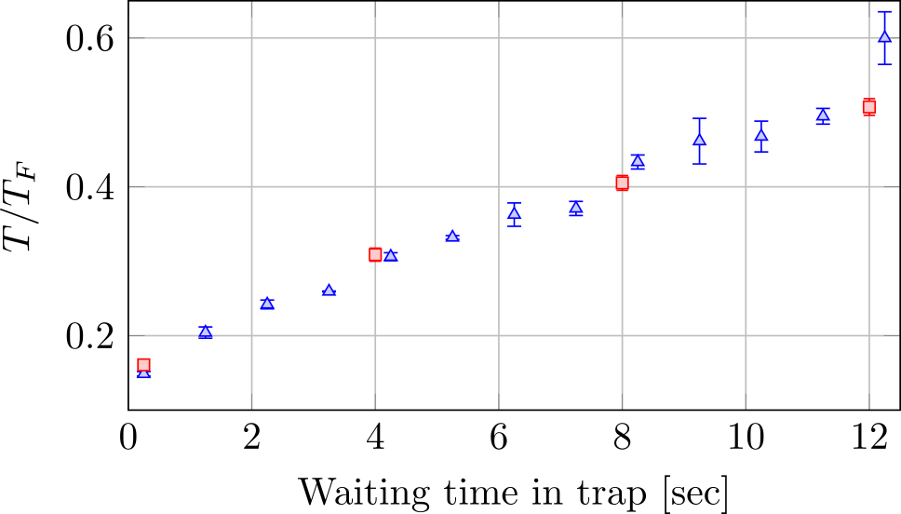
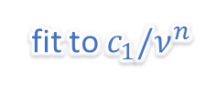
Rf and Raman Spectroscopy of a Degenerate Fermi Gas
fit to $c_{1}/ν^{n}$
C. Shkedrov, Y. Florshaim, GN, A. Gandman
and Y. Sagi, Phys. Rev. Lett. 121 (9), 093402
C. Shkedrov , GN, Y. Florshaim and Y. Sagi, arXiv:1909.12141 (2019)

Slide 5
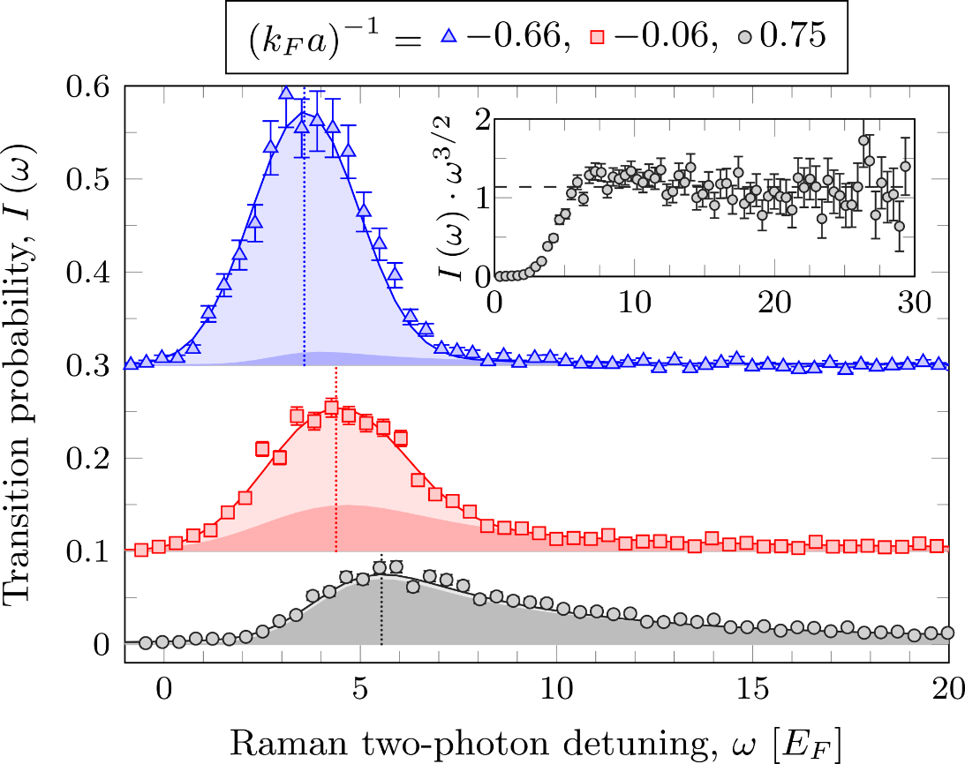
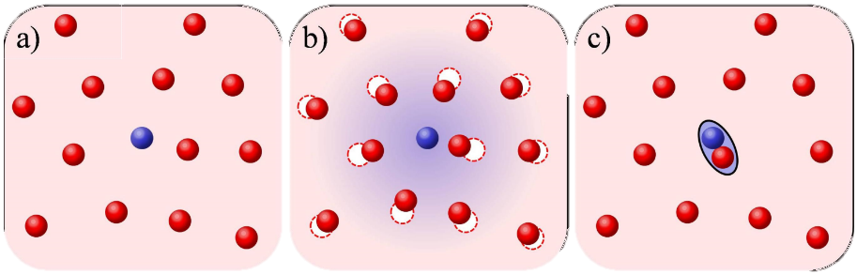
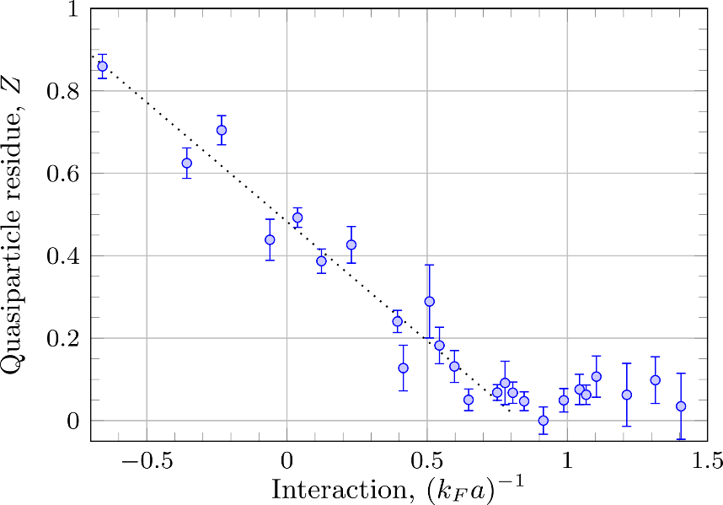
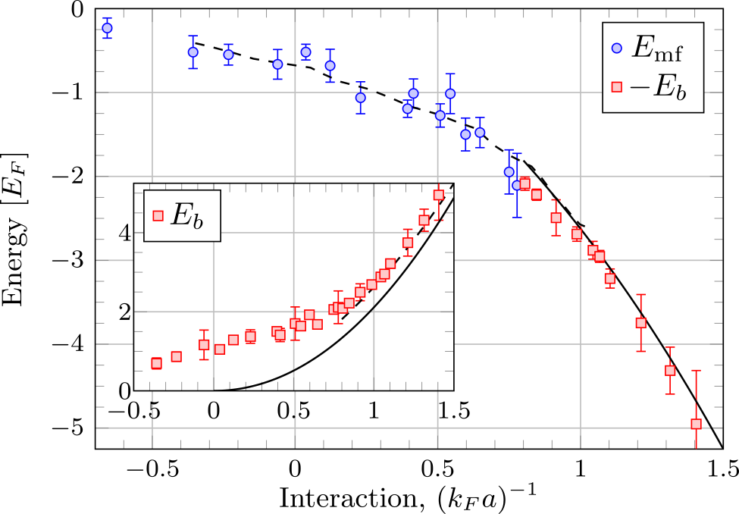
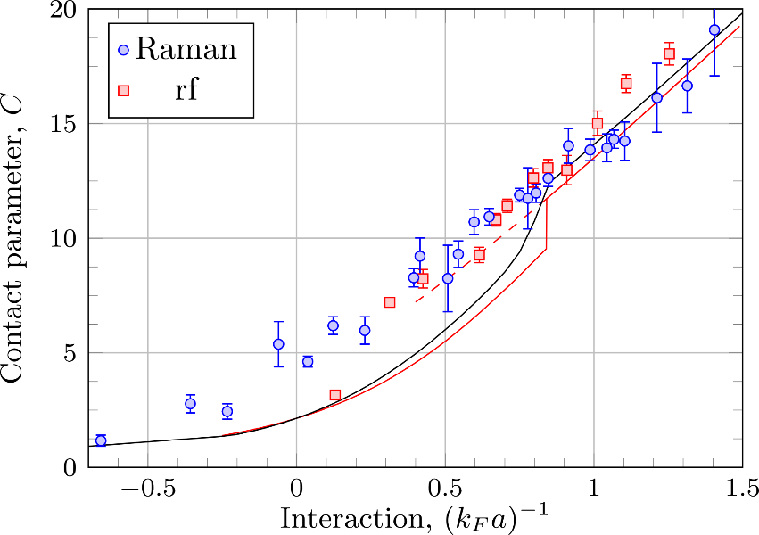
Probing the Attractive Polaron in a Degenerate Fermi Gas Using Raman Spectroscopy
Schirotzek et al., Phys. Rev. Lett. 102, 230402 (2009)

Slide 6
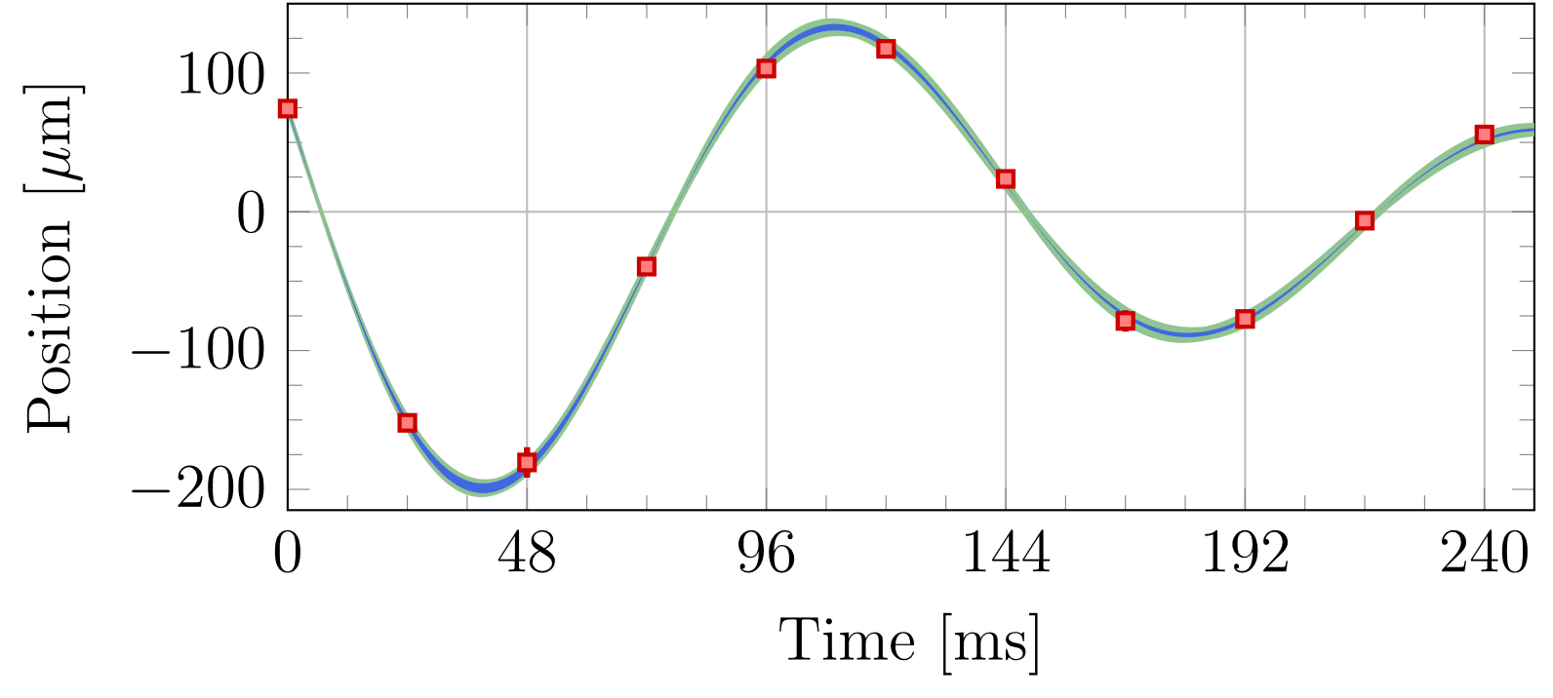
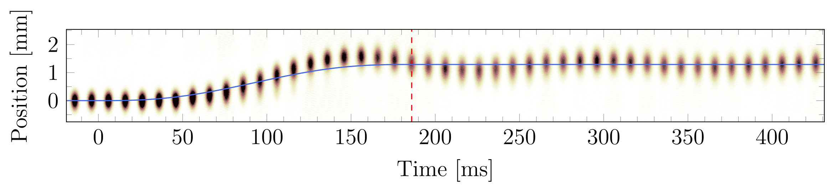
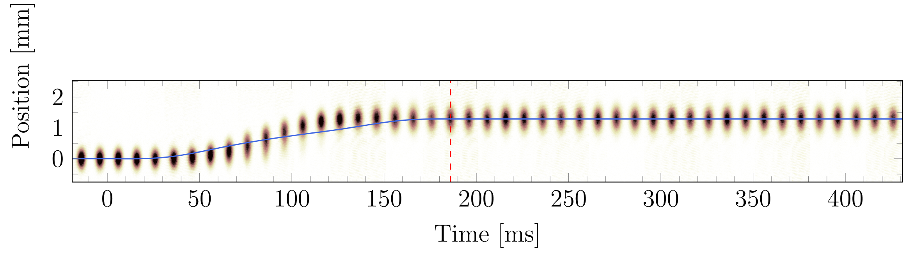
Highly non-adiabatic optical transfer of ultracold atoms
original
corrected
GN, C. Shkedrov, Y. Florshaim and Y. Sagi, New J. Phys. 20 095002 (2018)

Slide 7
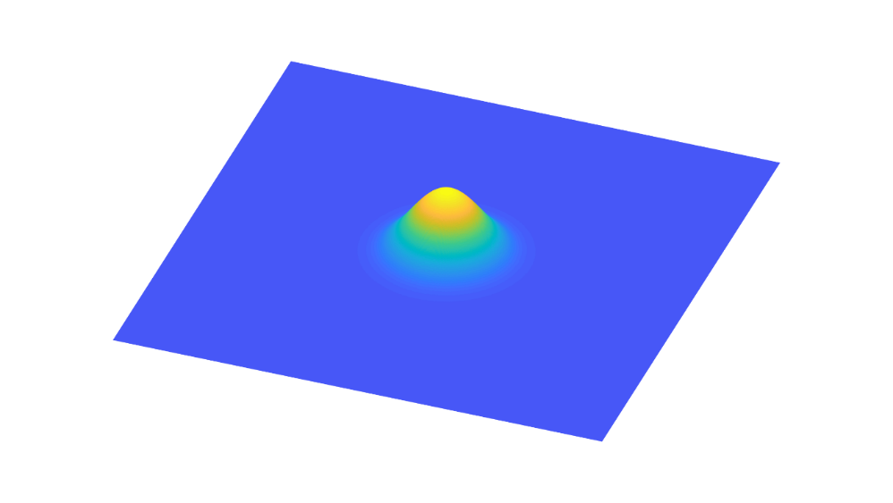
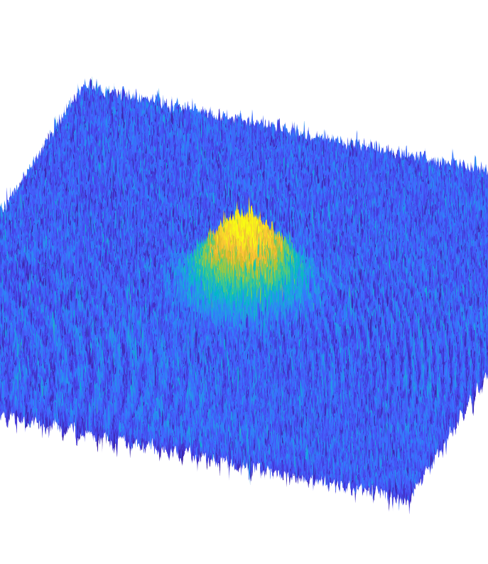
Deep-Neural-Network-based atomic absorption image denoising

Slide 8
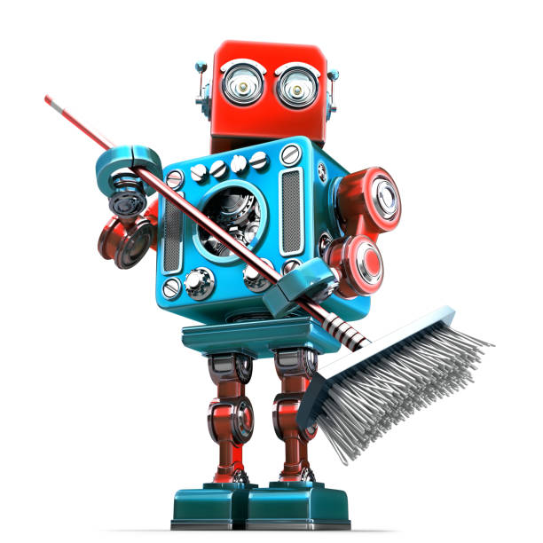
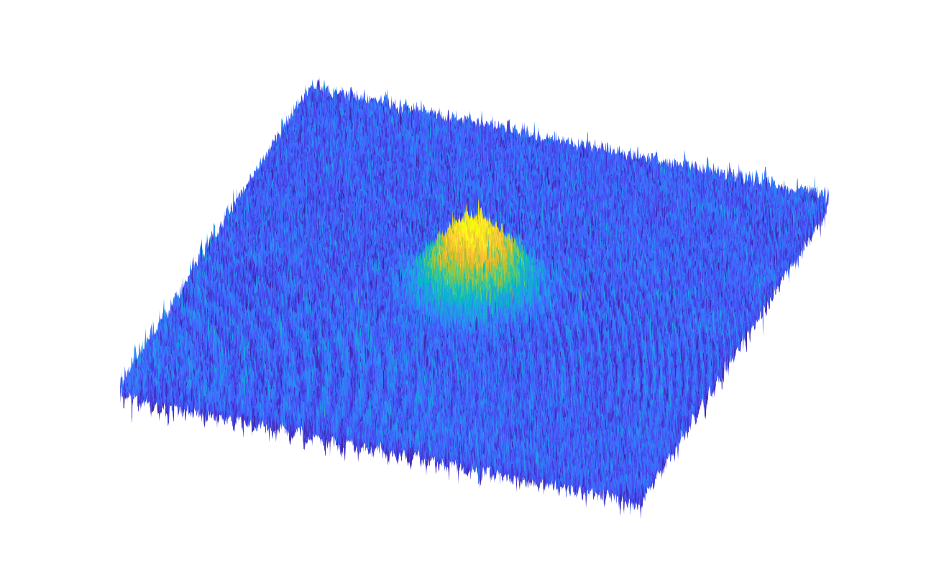
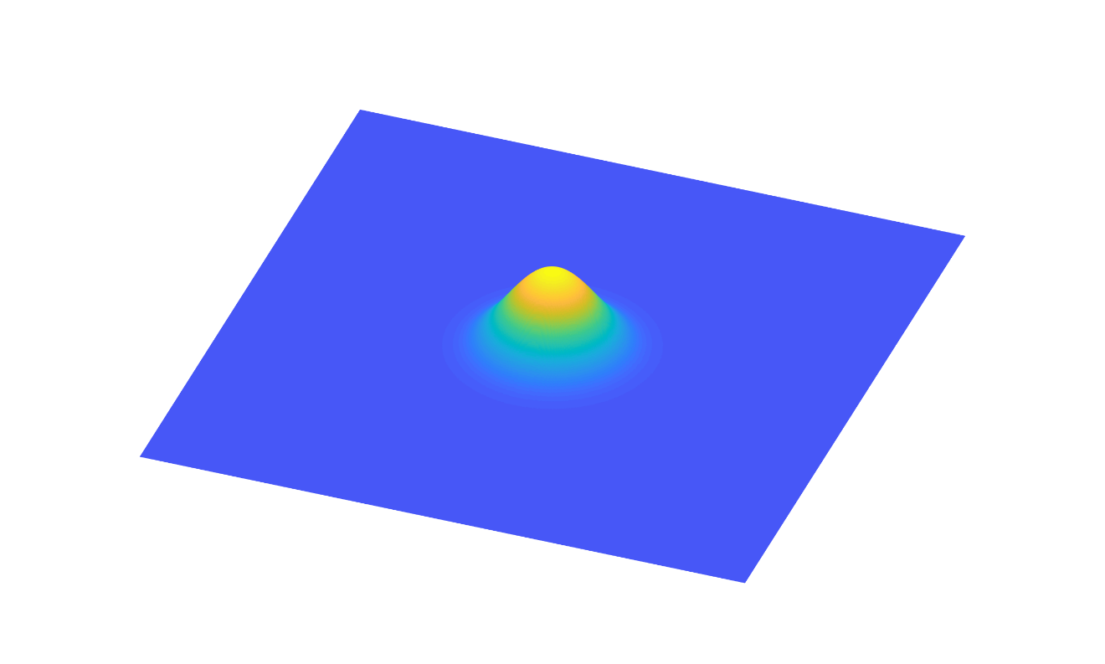
Goal
Use Deep-Neural-Network feature extraction ability to mitigate noise in atomic absorption images

Slide 9
Outline
1. Absorption imaging
2. AI, ML, CNN, DNN
3. absDL

Slide 10
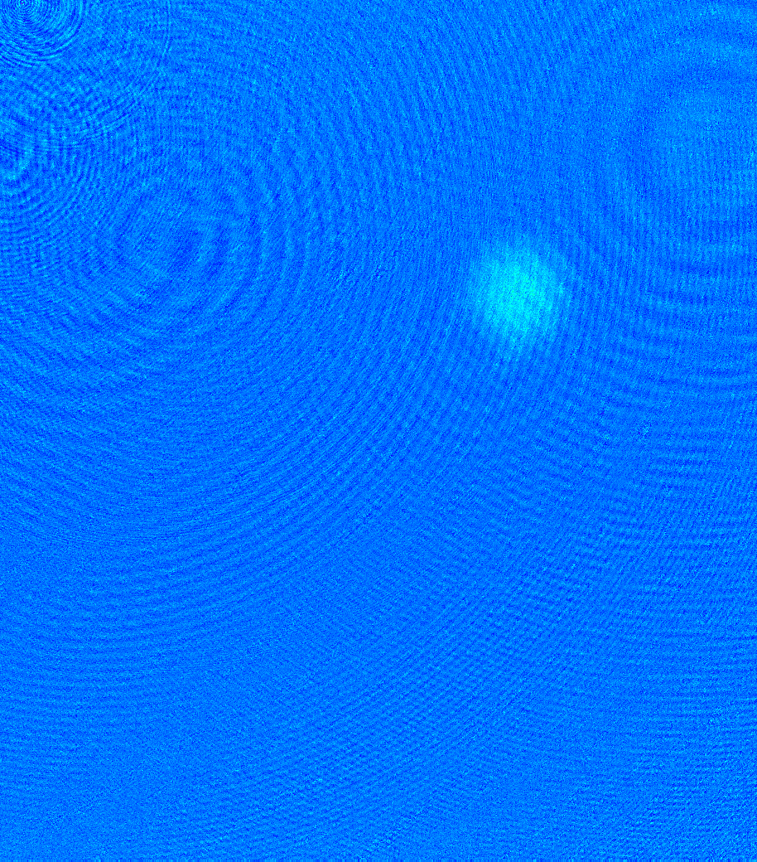
Atomic absorption imaging
and the science of fringe patterns

Slide 11

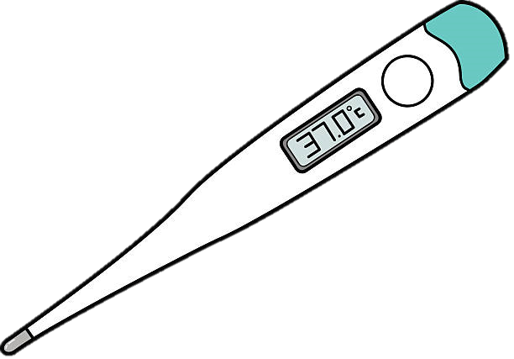
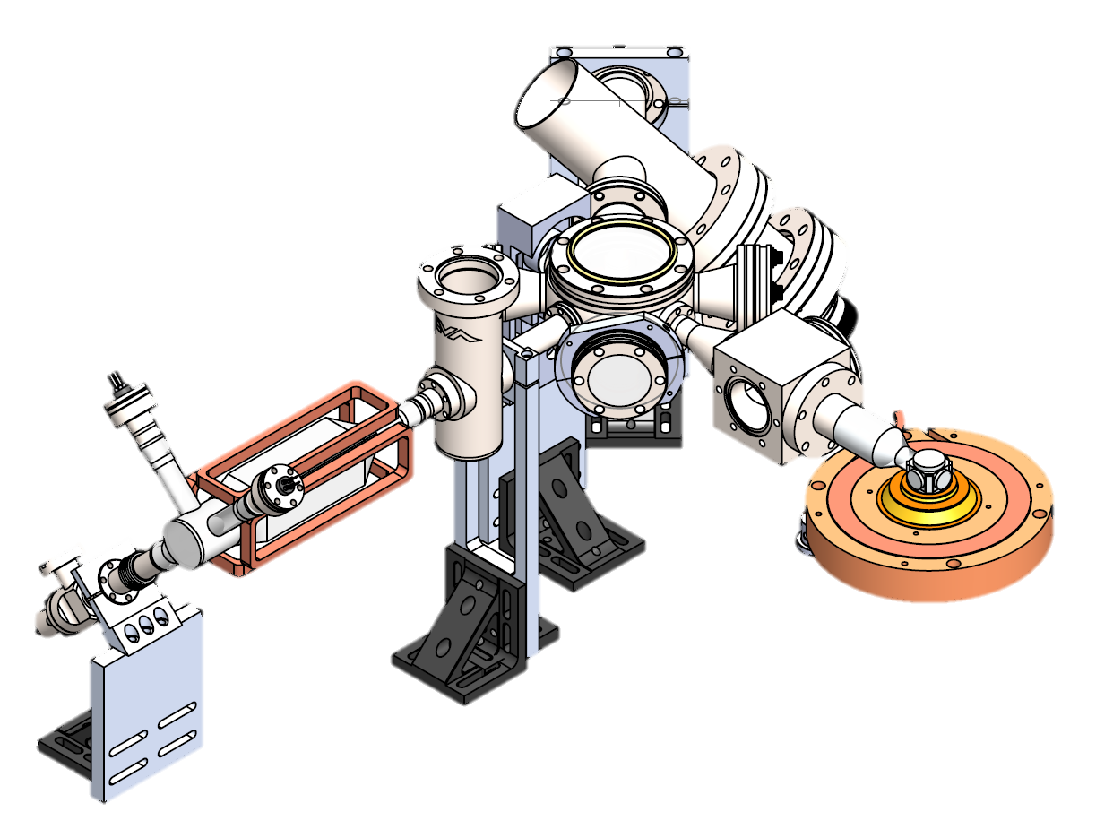
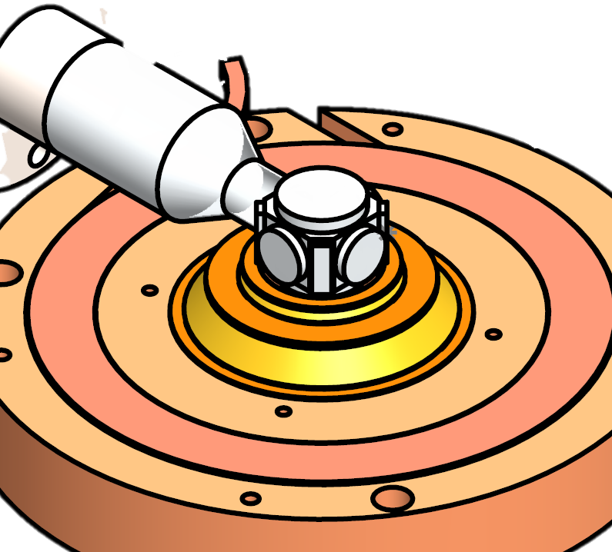
Dilute gases thermometry

Slide 12
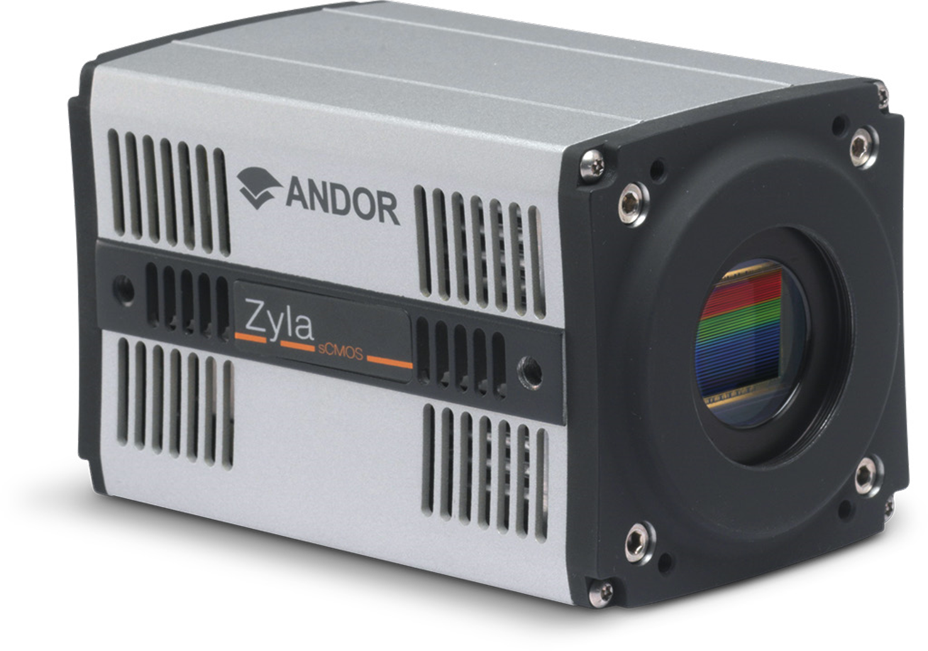
Absorption imaging
atoms
vacuum chamber

Slide 13
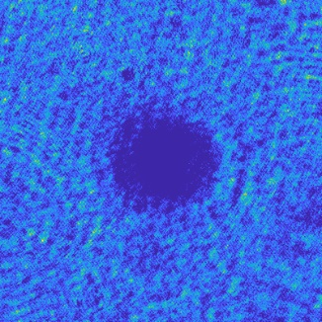
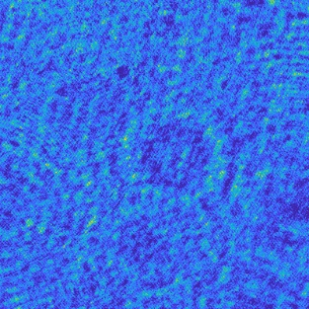
Absorption imaging
Atoms frame
Reference frame

Slide 14
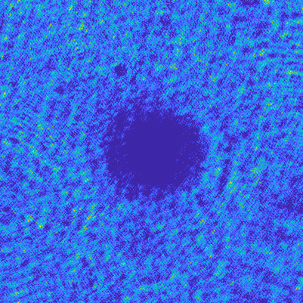
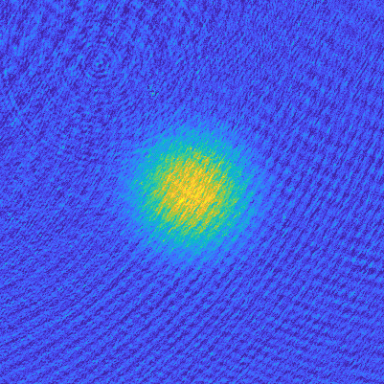

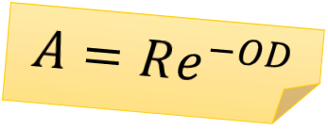
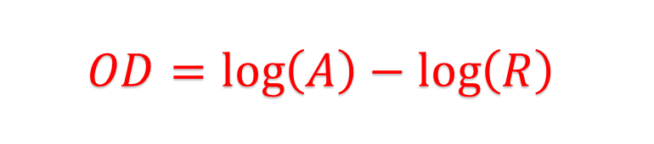
Absorption imaging
$$A=Re^{−OD}$$
$$OD=\log\left(A\right)−\log\left(R\right)$$
Atoms frame
0.45
1.75
Reference frame
0.1
-0.25

Slide 15
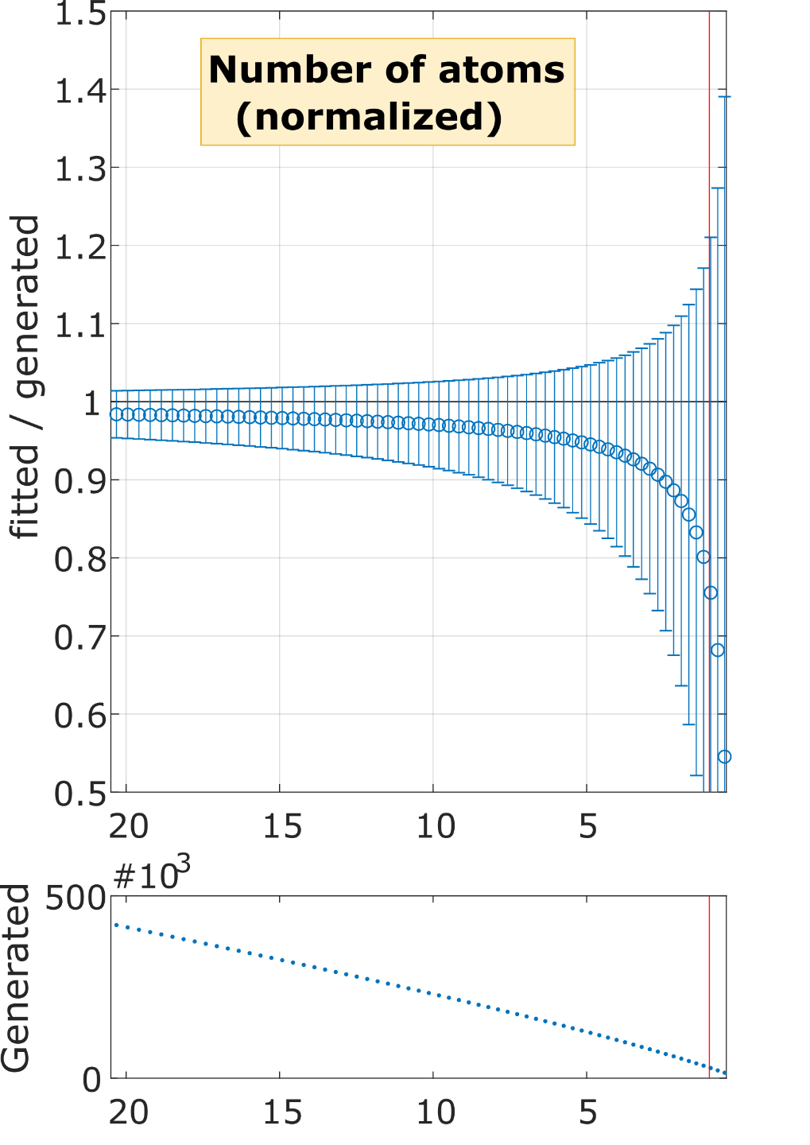
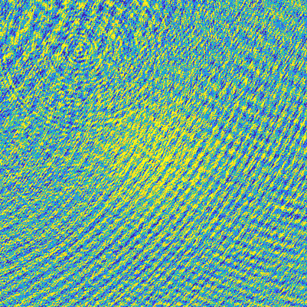
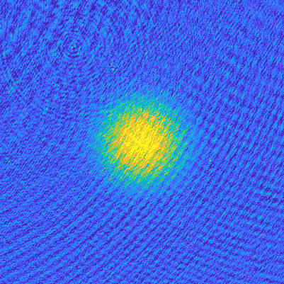
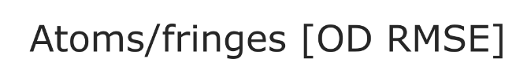
Quantifying fringes effect on synthetic data
0.25
1.25
-0.25
-0.25

Slide 16
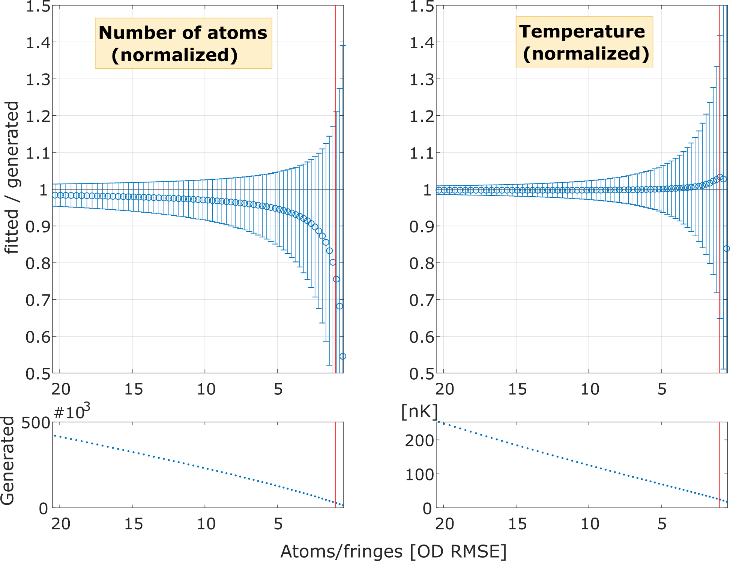
Quantifying fringes effect on synthetic data
1. Absorption imaging thermometry is noise sensitive

Slide 17
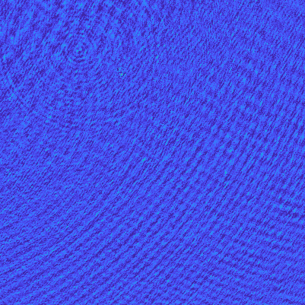
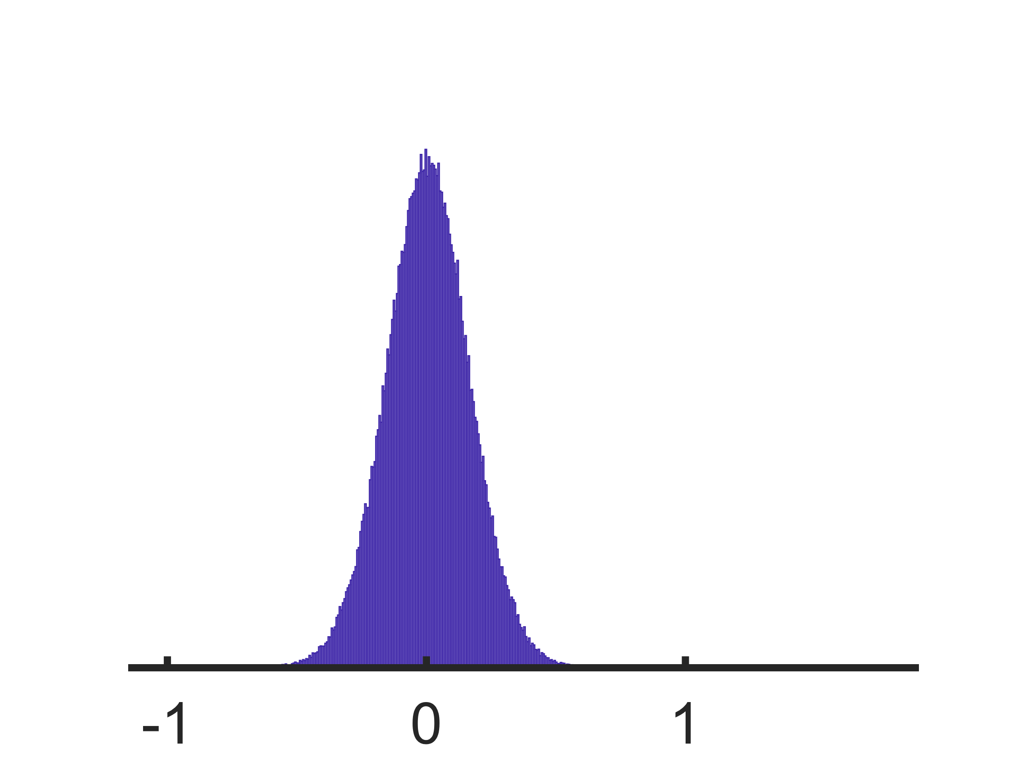
Fringe patterns
1.75
-0.25

Slide 18
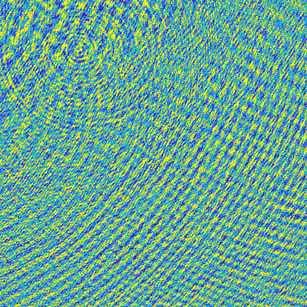
Fringe patterns
0.25
-0.25

Slide 19
Fringe patterns

Slide 20
Fringe patterns

Slide 21
Fringe patterns

Slide 22
Fringe patterns
2. Spatial correlations are useful

Slide 23
Fringe patterns
Niu et al., Optimized fringe removal algorithm for
absorption images, Appl. Phys. Lett. 113, 144103 (2018)
Masked reference
PCA
Reference frame

Slide 24



Fringe patterns
Niu et al., Optimized fringe removal algorithm for
absorption images, Appl. Phys. Lett. 113, 144103 (2018)
$$OD=\log\left(\frac{A}{R}\right)$$
Atoms frame
Ideal reference
PCA
Masked atoms

Slide 25


Principal component analysis results
Original OD
Denoised
0.6
-0.25

Slide 26


PCA results after a while
Original OD
“Denoised”
0.6
3. Long-term temporal correlations are not guaranteed
-0.25

Slide 27
Absorption imaging
1. Absorption imaging thermometry is noise sensitive
2. Spatial correlations are useful
3. Long-term temporal correlations are not guaranteed

Slide 28

Absorption imaging
Wanted: adaptable pattern extraction tool

Slide 29
Objectives
Reduce physical observables uncertainties
Avoid systematic errors
Run fast
Enable single-shot absorption imaging?

Slide 30

Machine Learning?
Touring the 2019 zoo of AI

Slide 31
Nomenclature
Artificial intelligence (AI)
A program that can sense, reason, act, and adapt
Machine learning (ML)
Not explicitly-programmed algorithms that improve by exposure to data
Convolutional Neural Networks (CNNs)
Regularized versions of multilayer perceptrons
Deep NN (DNNs)

Slide 32



NN principle
Extract abstract features from input data by a series of non-linear operations
is dog?
0

Slide 33












NN principles
$$f\left(x\right)$$
Perceptron
$$x_{0}$$
$$w_{0}$$
$$x_{1}$$
$$w_{1}$$
$$∑$$
$$x$$
$$y_{0}$$
$$x_{2}$$
$$w_{2}$$
$$w_{3}$$
sum
activation
output
$$x_{3}$$
weights
inputs

Slide 34







CNN principles
convolution
+activation
kernels

Slide 35




CNN principles
convolution
+activation
pooling
kernels

Slide 36


CNN training
convolution +activation + pooling
convolution +activation + pooling
convolution +activation + pooling
convolution +activation + pooling
convolution +activation + pooling
back propagation
convolution +activation + pooling
$${\left(f\left(g\left(x\right)\right)\right)}^{′}=f^{′}\left(g\left(x\right)\right)g′\left(x\right)$$
convolution +activation + pooling
convolution +activation + pooling
convolution +activation + pooling
is dog?
0.5
loss
kernels

Slide 37
CNN training
convolution +activation + pooling
convolution +activation + pooling
convolution +activation + pooling
convolution +activation + pooling
convolution +activation + pooling
back propagation
convolution +activation + pooling
$${\left(f\left(g\left(x\right)\right)\right)}^{′}=f^{′}\left(g\left(x\right)\right)g′\left(x\right)$$
convolution +activation + pooling
convolution +activation + pooling
convolution +activation + pooling
is dog?
0.4
loss
kernels

Slide 38

CNN training
convolution +activation + pooling
convolution +activation + pooling
convolution +activation + pooling
convolution +activation + pooling
convolution +activation + pooling
back propagation
convolution +activation + pooling
$${\left(f\left(g\left(x\right)\right)\right)}^{′}=f^{′}\left(g\left(x\right)\right)g′\left(x\right)$$
convolution +activation + pooling
convolution +activation + pooling
convolution +activation + pooling
is dog?
0.2
loss
kernels

Slide 39
CNN training
convolution +activation + pooling
convolution +activation + pooling
convolution +activation + pooling
convolution +activation + pooling
convolution +activation + pooling
back propagation
convolution +activation + pooling
$${\left(f\left(g\left(x\right)\right)\right)}^{′}=f^{′}\left(g\left(x\right)\right)g′\left(x\right)$$
convolution +activation + pooling
convolution +activation + pooling
convolution +activation + pooling
is dog?
0.02
loss
kernels

Slide 40
CNN training
convolution +activation + pooling
convolution +activation + pooling
convolution +activation + pooling
convolution +activation + pooling
convolution +activation + pooling
back propagation
convolution +activation + pooling
$${\left(f\left(g\left(x\right)\right)\right)}^{′}=f^{′}\left(g\left(x\right)\right)g′\left(x\right)$$
convolution +activation + pooling
convolution +activation + pooling
convolution +activation + pooling
is dog?
0.001
loss
kernels

Slide 41
CNN training
convolution +activation + pooling
convolution +activation + pooling
convolution +activation + pooling
convolution +activation + pooling
convolution +activation + pooling
back propagation
convolution +activation + pooling
$${\left(f\left(g\left(x\right)\right)\right)}^{′}=f^{′}\left(g\left(x\right)\right)g′\left(x\right)$$
convolution +activation + pooling
convolution +activation + pooling
convolution +activation + pooling
is dog?
0.000001
loss
kernels

Slide 42

State of the art

Slide 43


Absorption image DNN denoising
absDL
Deep-learning against fringes

Slide 44
Training stage
OD image
Image completion
Masked OD

Slide 45
Evaluation stage
OD image
Image completion
Masked OD

Slide 46


Current architecture
Ronneberger et al., U-Net: Convolutional Networks
for Biomedical Image Segmentation, arXiv:1505.04597
more “what”
less “where”
contraction
expansion
loss
skip links

Slide 47
Current architecture
9,120,673 trainable parameters
loss

Slide 48

Random cropping on 12k dual-image dataset

Slide 49









Learning process
Model input
training
-
epoch 1
epoch 10
epoch 30
epoch 190
Model output
Difference
-0.15
0.15

Slide 50












Model input
-
Model output
Difference
-0.15
0.25

Slide 51

Effect on physical observables
PRELIMINARY
RESULTS

Slide 52

Next steps: Single shot imaging
1
2
Use pre-captured Reference
Complete the Atoms image directly

Slide 53

Evaluate ideal reference at your lab
The model (will soon be) available on:
absDL.github.io
absDL

Slide 54
Summary
Absorption image denoising requires adaptable solution
U-Net based architecture provides robust results
Outlook: generalization, single shot

Slide 55


Thank you!
Questions?

Slide 56



Outline

